Slide 1
Signals of Mental Health in Twitter Language
Andrew D and Taylor S

Slide 2
Research Questions
Can language in tweets be used to identify signs of mental health conditions such as anxiety, loneliness, and stress?
Are there patterns or trends in the data within topics?

Slide 3
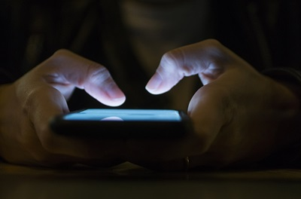
Motivation
When individuals experience stress, anxiety, loneliness, or other emotional struggles, they often turn to social media to express themselves, seek support, or simply be seen by others. We are interested in finding any trends related to common topics, the language surrounding them, and finding any patterns in demographics.

Slide 4
Dataset #1
This data set is from Kaggle and contains rows of tweets that were scraped from twitter.
They are already sorted into categories of
Normal_Tweets
Anxious_Tweets
Lonely_Tweets
Stressed_Tweets
There are 8535 stressed tweets, 9925 normal tweets, 8522 lonely tweets, and 10509 anxious tweets

Slide 5
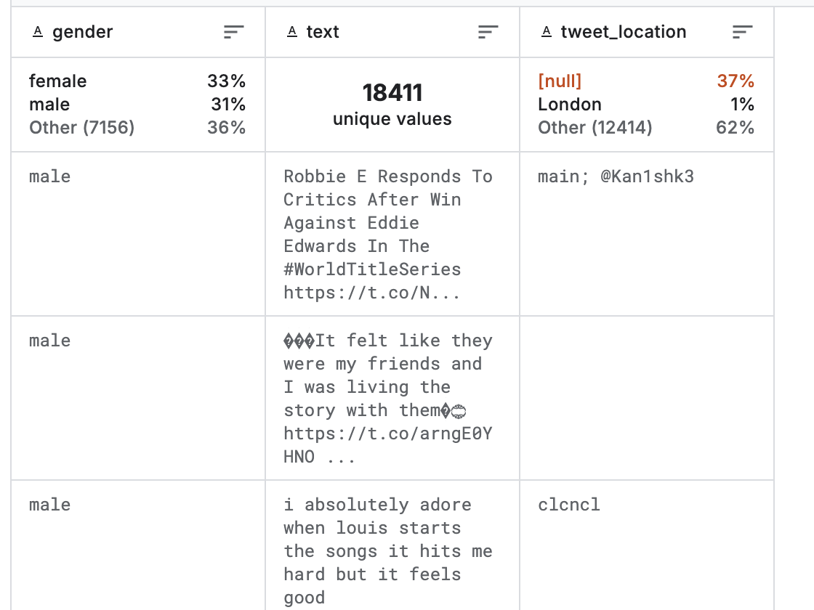
Dataset #2
This data set is from Kaggle and contains rows of tweets that were scraped from twitter.
The data set has 20,000 rows, each with a username, a random tweet, and some demographics about the tweeter including gender.

Slide 6
Preprocessing
Preprocessing Steps:
Lowercasing, removing punctuation and numbers
Stopword removal and short-word filtering
Tokenization (text2vec package)
Sampling:
Randomly sampled 50 tweets of each emotion and combined into dataset
Ran model on that set
Repeated 50 times and took average evaluation scores

Slide 7
Method
We used three Approaches to find the best accuracy
Average accuracy
Doc Embeddings + k-Means Clustering (Unsupervised)
TF-IDF + k-Means Clustering (Unsupervised)
Doc Embeddings + Random Forest (Supervised)
0.503
0.340
0.533

Slide 8
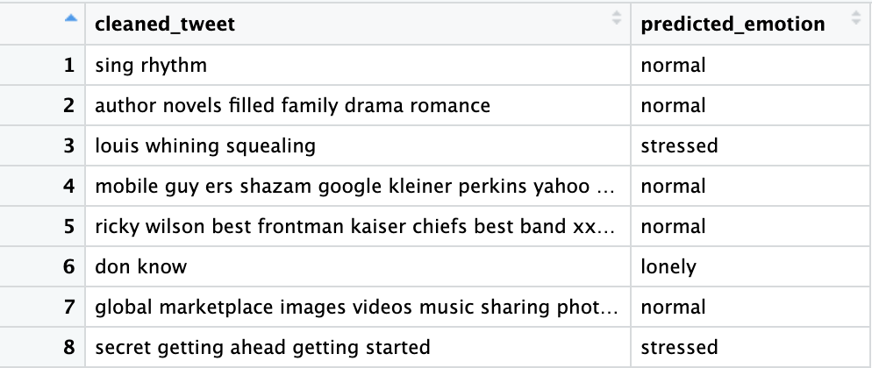
Method
We then used the random forest model to train the new data set of tweets
Applied a new column of emotions to each tweet

Slide 9
BERT Results
Cluster
Top words
Topic label
1 | world, time, sports, media, writer, student | News & Student Life
2 | twitter, writer, sports, business, free, lover | Online Expression & Business
3 | business, design, market, blog, online | Entrepreneurship & Marketing
4 | sports, lover, twitter, business, people | Pop Culture & Sports
5 | world, student, writer, marketing, instagram, gym | College & Personal Branding
6 | writer, instagram, lover, girl, tweets, sports | Social Media Identity
7 | world, writer, business, media, god | Personal Reflection & Media
8 | writer, tweets, business, sports, people, marketing | Content Creators & Branding
9 | world, speak, reality, brand, independent, cultural | Social Commentary & Culture
10 | world, business, time, account, instagram, writer | Professional/Work-Life Balance

Slide 10
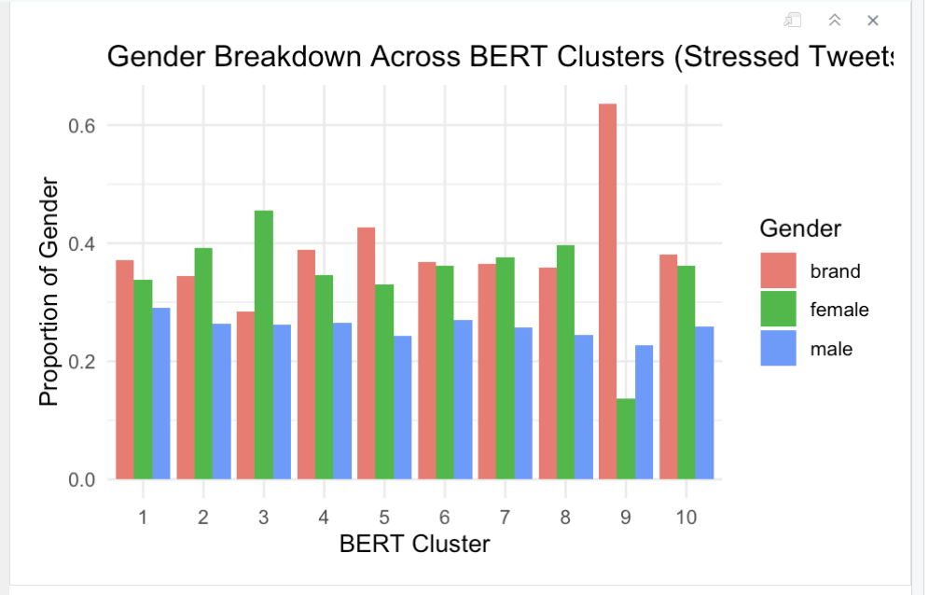
Gender breakdown across stressed tweets in all 10 clusters
Analyzing gender and brand breakdowns within stressed tweets revealed that cluster 9 had a strikingly high proportion of brand accounts, suggesting that this topic is driven more by bots and AI voices than individuals. In contrast, clusters such as 3 show stronger female representation, indicating greater individual engagement in those stress-related topics.

Slide 11
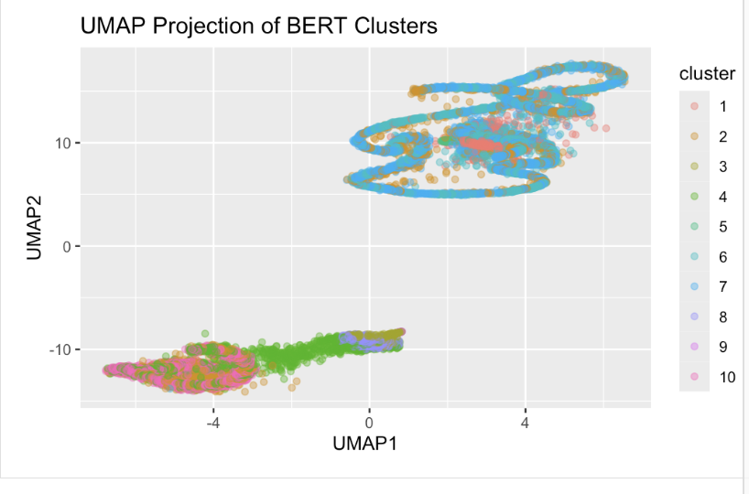
UMAP projection of BERT
The UMAP projection of BERT clusters reveals clear separability among topics in the tweet dataset. Clusters 1 through 10 are in distinct regions in the 2D embedding space, suggesting that the k-means clustering on BERT embeddings successfully grouped semantically similar tweets

Slide 12
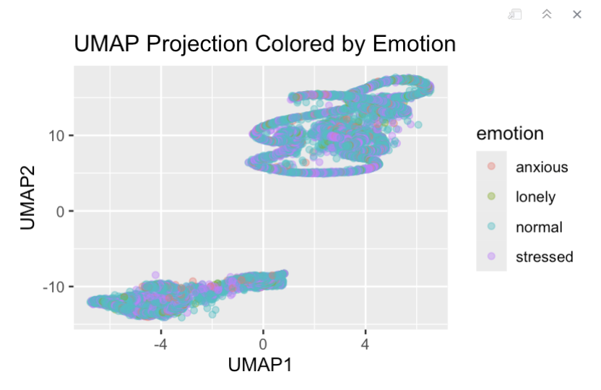
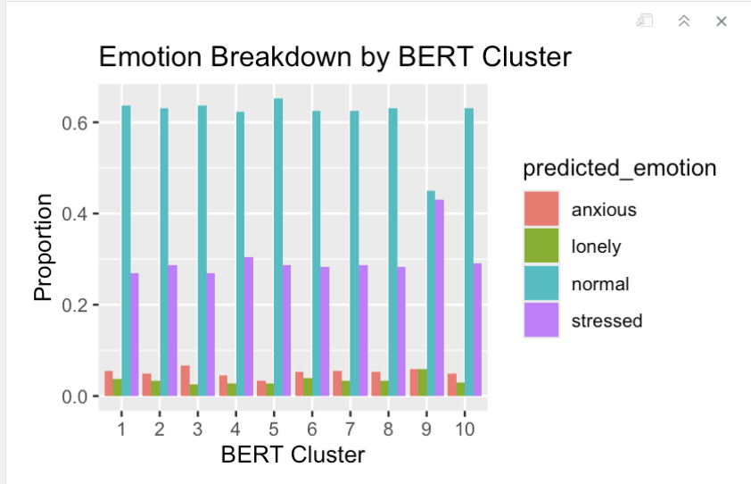
UMAP projection of emotion
The UMAP projection reveals that emotional states are distributed across multiple topical clusters, suggesting that each topic can be associated with multiple emotional responses.

Slide 13
Implications
We trained a classifier that was able to identify the predicted emotional states of anxious, stress, lonely, and normal. The predictions were then grouped into BERT clusters and the UMAP projections showed the emotional states distributed across all topics demonstrating a relationship between language use and emotional content.
Some trends we noticed:
In cluster 3 which is Entrepreneurship & Marketing - there was a significantly higher proportion of females showing stress than brand or males
Cluster 9 had a very high proportion of brand accounts, suggesting institutional or automated voices dominated Social Commentary & Culture.
Emotional tone varied across clusters: some were heavily “normal,” others skewed “anxious” or “lonely.”

